Slide 1
ZZ101 Records
The real alternative

Slide 2
The start of zz101
Created in 1999
  Shawn “Little Z” Hayes
  Malcolm “Bondo” Alexander
South L.A. warehouse
  4 employees
2 original signed artists
4 original investors

Slide 3
Where we are today
Net worth +100mil
Total sales +50mil
Profitability near 25%
Growth potential: double in 2 years
  Market share : +20% in 5 years
Debt under 40%

Slide 4
Our bands
The Outcasts
4Trends
Ice Cold
FastForward Boys
HQ

Slide 5


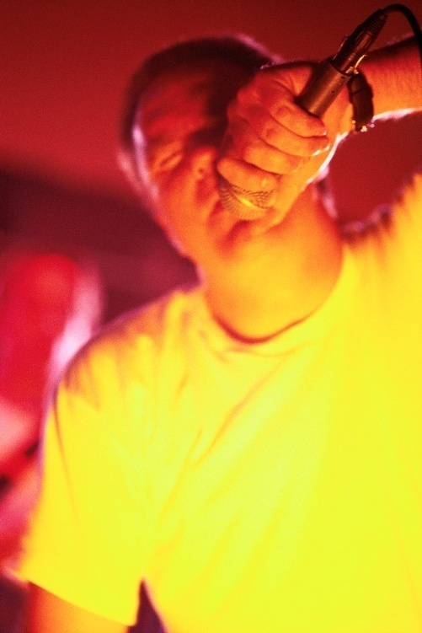
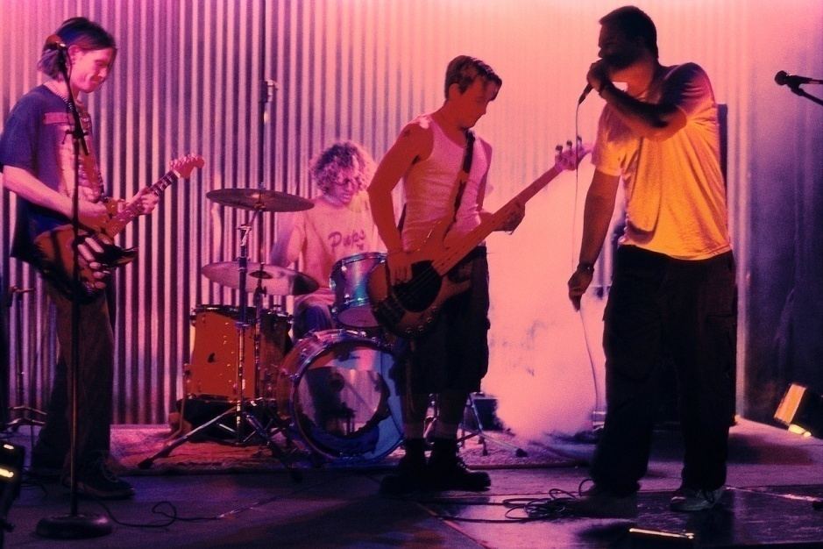
Ice Cold
4Trends
HQ
FastForward Boys

Slide 6
our plan
Flood Internet markets
Open channels to distribute Internationally
Compile CD and MP3 collections
Sign 3 additional artists
  Have 2 artists in preliminary talks

Slide 7
ZZ101
RECORDS
The real alternative
ZZ101
1470 SE Hollywood Street, Suite 1420
Los Angeles, California 90362

